Slide 1
Domain : HR Analytics
Project Name: Employee Retention

Slide 2
Details of Group-3
Group Members :
Gandam Pranay Kumar
Smita Sunil Kesapure
Kakanuru Lakshmi Sunanda
Kanaka Thabitha Catherina
Sanam Venkata Siva
Sayali Banti Khilare
Mule Soma Sundar Reddy

Slide 3
Introduction
To analyse employee retention and satisfaction by identifying key factors that influence attrition within the organization.
Scope: The analysis examines various employee attributes, including demographics, job roles, compensation, job satisfaction, and work-life balance, to uncover patterns that affect retention.
Importance:
Develop targeted strategies to reduce turnover.
Enhance employee satisfaction and engagement.
Optimize HR practices for better talent management.

Slide 4
Objectives
Identify the factors leading to employee attrition.
Evaluate the satisfaction levels across different departments and roles.
Analyse the impact of work-life balance, salary hikes, and years at the company on retention.
Provide actionable insights for improving employee retention.

Slide 5
Exploratory Data Analysis
Attrition Trends: Identified high-risk groups by analysing attrition rates across departments, job roles, Income.
Demographic Insights: Explored how age, gender, and marital status correlate with job satisfaction and job roles.
Work-Life Balance: Analysed the relationship between work-life balance scores and employee satisfaction across departments.
Job Satisfaction: Assessed job satisfaction levels by department and role to identify areas needing improvement.

Slide 6
Data Modeling
Data Modeling
Data Fields: Key fields include attrition status, age, department, job role, salary, work-life balance, years at the company, job satisfaction, and more.
Derived Fields: Created calculated fields such as income groups, Working Experience groups, and Attrition Rate.
Modeling Approach: Analysed the relationship between different variables to identify patterns and trends

Slide 7
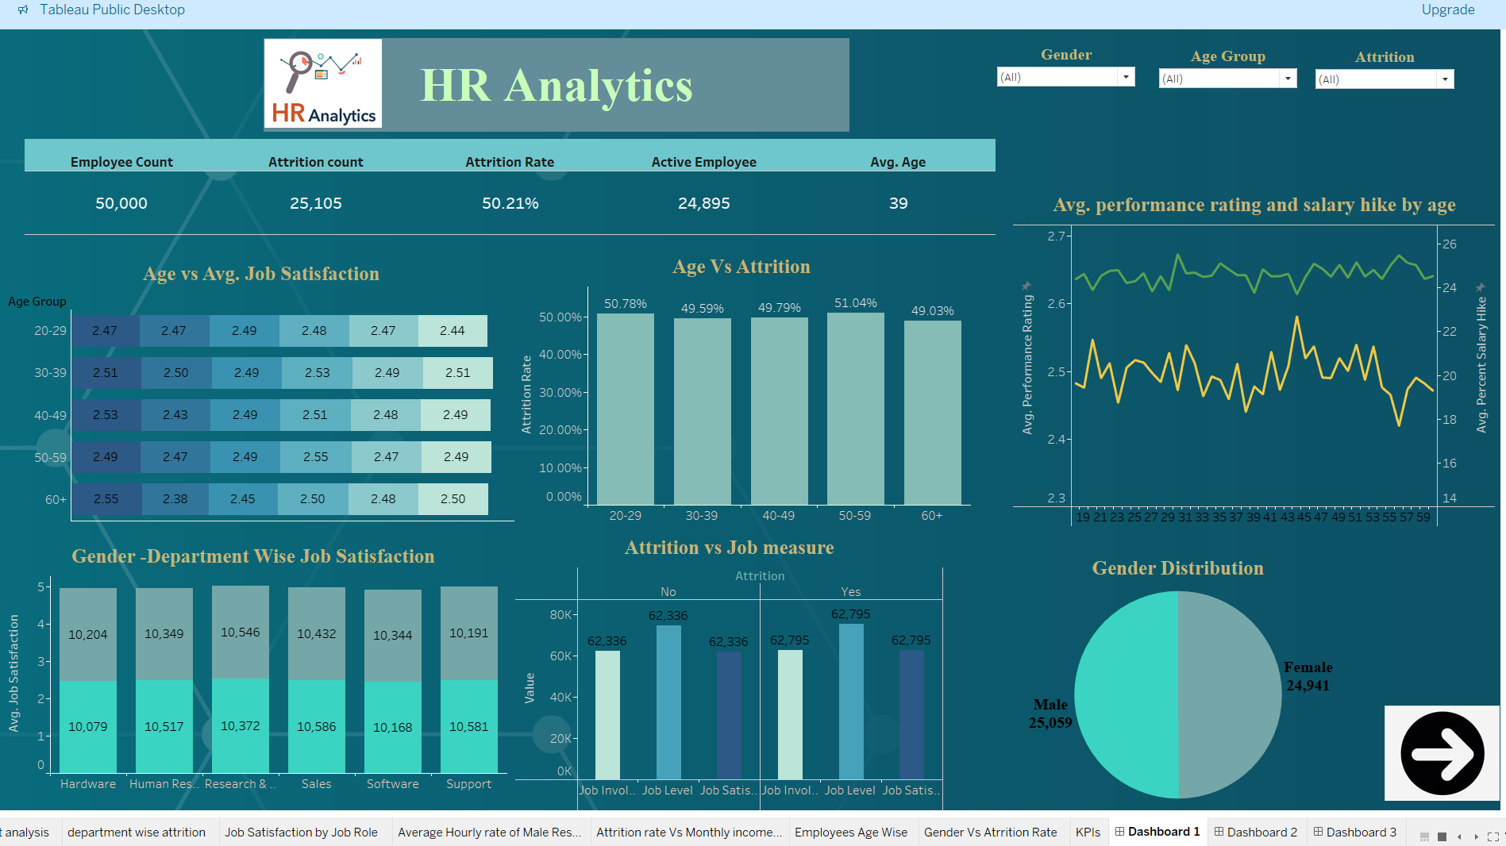
Dashboard with KPI’s

Slide 8
Insights and Findings
Key Insights and Findings:
High Attrition Rate:50.21% attrition with 25,105 employees leaving, highlighting a major challenge.
Age and Satisfaction: Satisfaction is consistent across age groups, with the highest attrition in the 50-59 age group.
Performance and Salary: Salary hikes decrease with age, while performance ratings remain stable.
Gender Distribution: Near-equal gender split: 50.12% male and 49.88% female.
Job Satisfaction: Satisfaction levels are similar across genders and departments.
Attrition and Job Involvement: Higher job involvement and satisfaction correlate with lower attrition.

Slide 9
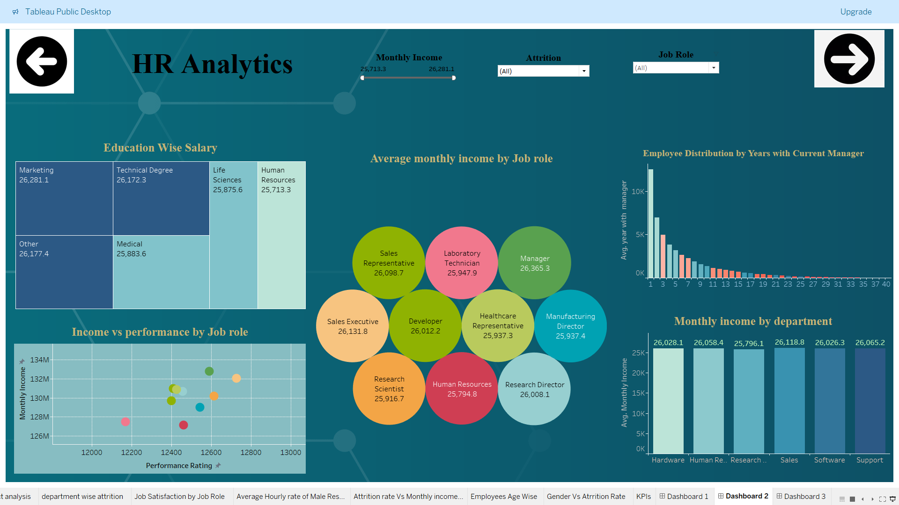
Dashboard with KPI’s

Slide 10
Insights and Findings
Key Insights and Findings:
Marketing has the highest average salary (26,281.1), while Life Sciences earns the least (25,875.6).
Managers and Manufacturing Directors are the top earners (26,365.3 and 26,008.1).
Most employees have 1-4 years with their current managers; tenure drops sharply after 10 years.
Higher performance ratings correlate with higher income across roles.
Hardware and Support departments lead in average income (both above 26,000).

Slide 11
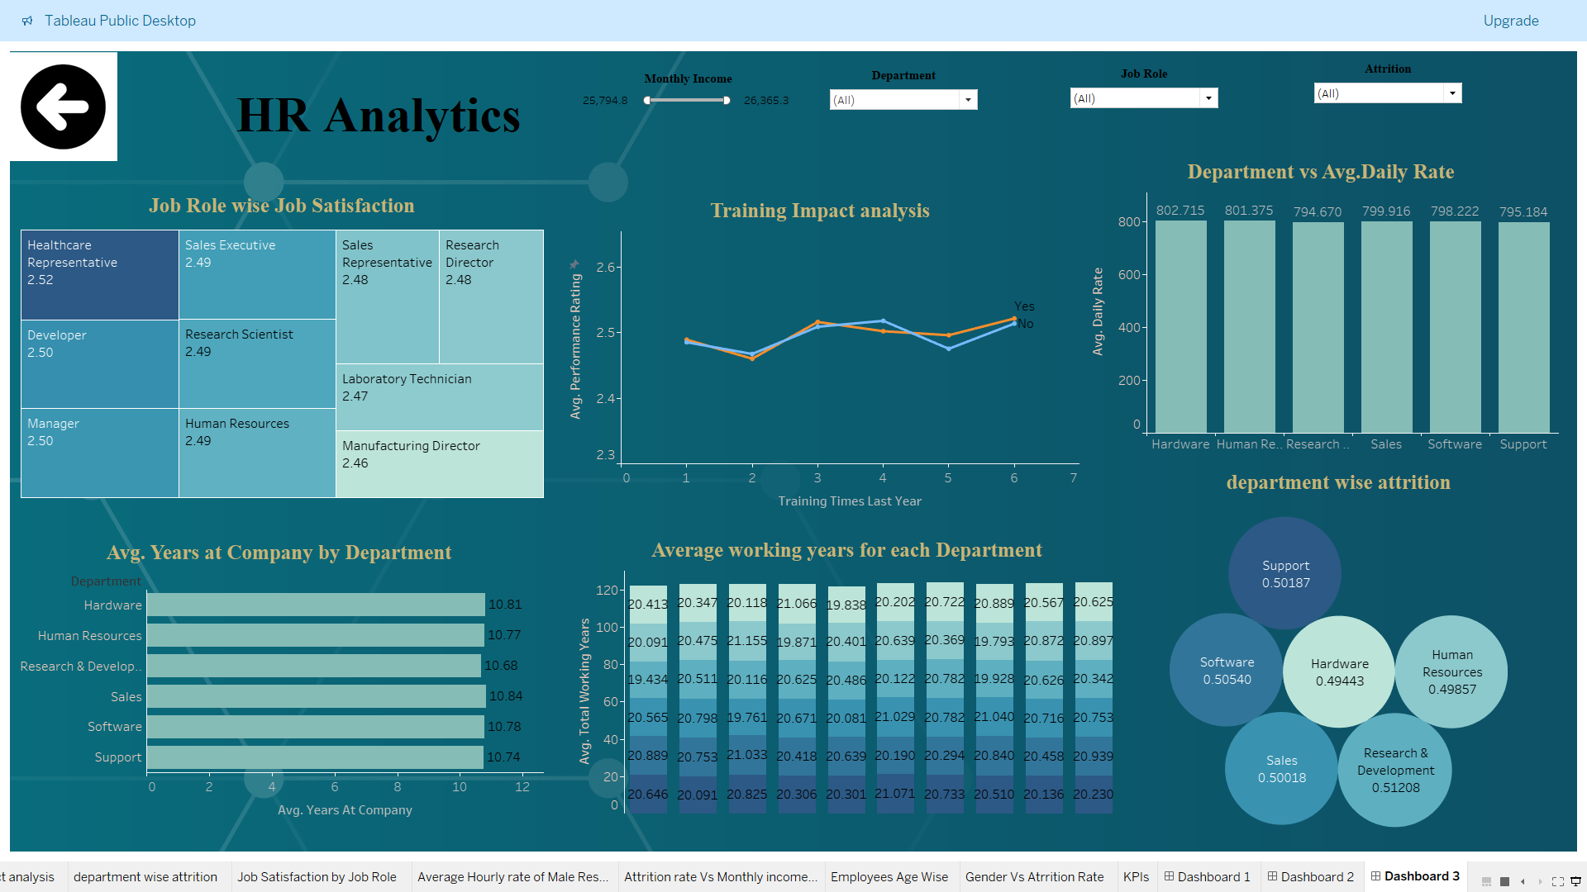
Dashboard with KPI’s

Slide 12
Insights and Findings
Job Satisfaction: Minimal variance across roles with all scores close to 2.5.
Employee Tenure: Highest in Hardware, Sales, and Software departments, indicating strong retention.-
Training Impact: Slight performance improvement with more training.-
Attrition Concentration: Higher in Support, Sales, and Software departments.
Working Years: Shortest tenure in Support, longest in Hardware.

Slide 13
CONCLUSION
Significant Attrition Challenge: With over 50% attrition, addressing retention, especially among experienced employees, is crucial.
Salary and Performance: Higher income aligns with better performance, yet salary growth slows with age, indicating potential for reassessment of compensation strategies.
Employee Engagement: Job satisfaction and involvement are key drivers in reducing attrition, emphasizing the need for sustained employee engagement initiatives.
Tenure Trends: Most employees have short tenures with managers, particularly dropping after 10 years, which may impact organizational stability and performance.

Slide 14
THANK YOU!!

